Slide 1

Networking standards

Slide 2
Implement and diagnose networked systems
Devices:
Installation of communication devices, allocation of addresses, local client configuration, server configuration, server installation, security considerations.

Slide 3
Verification of configuration and connectivity:
Installation of internet work communication medium, ping, extended ping, traceroute, telnet, SSH.

Slide 4
System monitoring:
Utilization, bandwidth needs, monitoring user productivity and security of the system.

Slide 5
Monitoring
the Network
Connecting Networks
- Syslog
- SNMP
- NetFlow
- Summary

Slide 6
▪ Explain syslog operation in a small-to-medium-sized business
network.
▪ Configure syslog to compile messages on a small-to-medium-sized
business network management device.
▪ Explain syslog operation in small-to-medium-sized business
network.
▪ Configure SNMP to compile messages on a small-to-medium-sized
business network.
▪ Describe NetFlow operation in a small-to-medium-sized business
network.
▪ Configure NetFlow data export on a router.
▪ Examine sample NetFlow data to determine traffic patterns.

Slide 7
Syslog

Slide 8
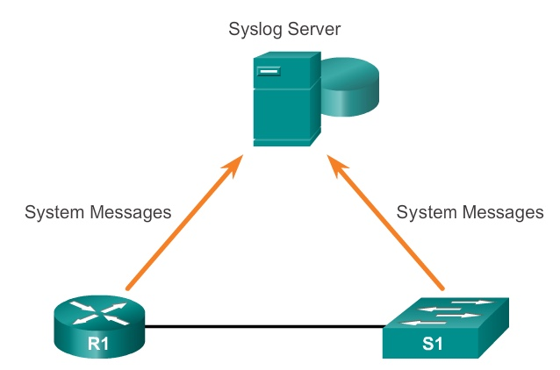
Syslog Operation
Introduction to Syslog

Slide 9
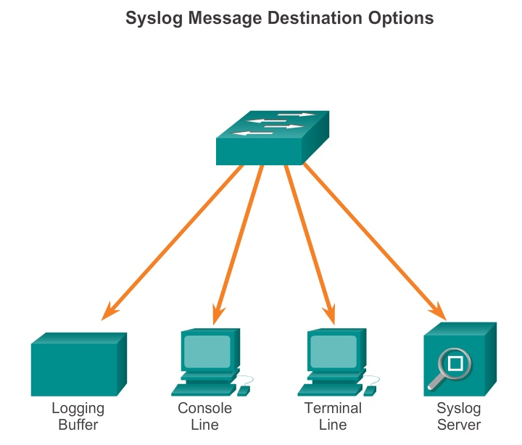
Syslog Operation
Syslog Operation

Slide 10
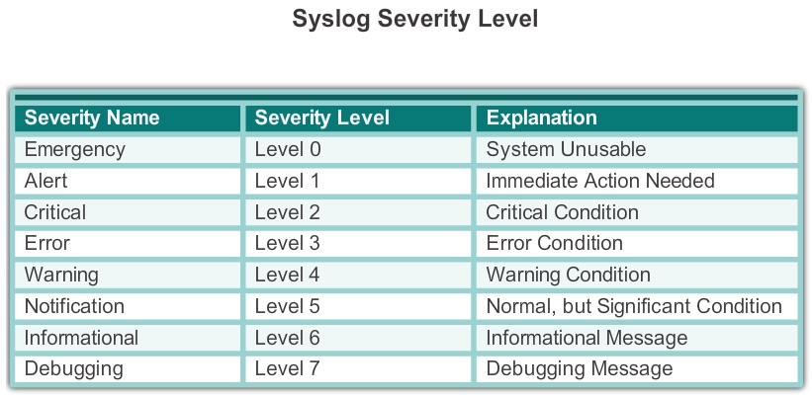
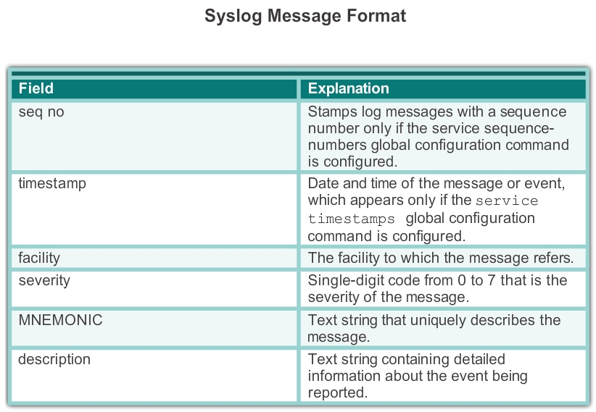
Syslog Operation
Syslog Message Format

Slide 11
Syslog Operation
Service Timestamp
▪ Log messages can be time-stamped and the source address of
syslog messages can be set. This enhances real-time debugging
and management.
▪ The service timestamps log datetime command entered
in global configuration mode should be entered on the device.
▪ In this chapter, it is assumed that the clock has been set and the
service timestamps log datetime command has been
configured on all devices.

Slide 12
Configuring Syslog
Syslog Server
▪ The syslog server provides a relatively user-friendly interface for
viewing syslog output.
▪ The server parses the output and places the messages into pre-
defined columns for easy interpretation. If timestamps are
configured on the networking device sourcing the syslog
messages, then the date and time of each message displays in the
syslog server output.
▪ Network administrators can easily navigate the large amount of
data compiled on a syslog server.

Slide 13
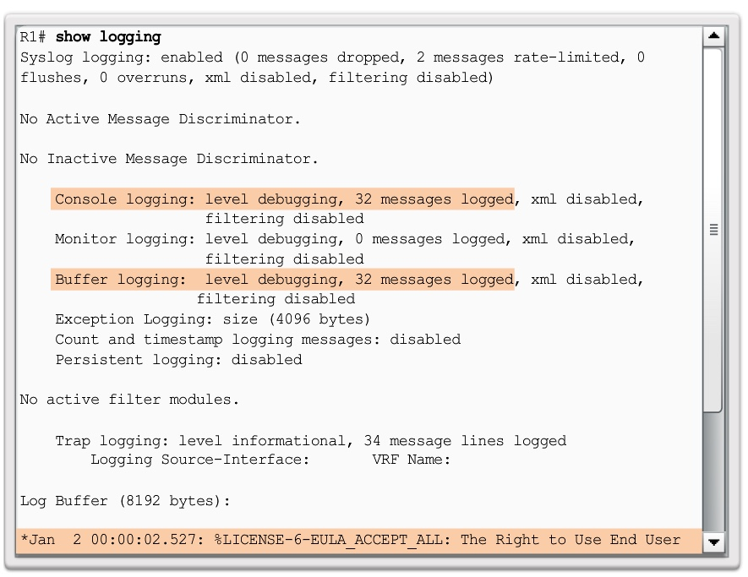
Configuring Syslog
Default Logging

Slide 14
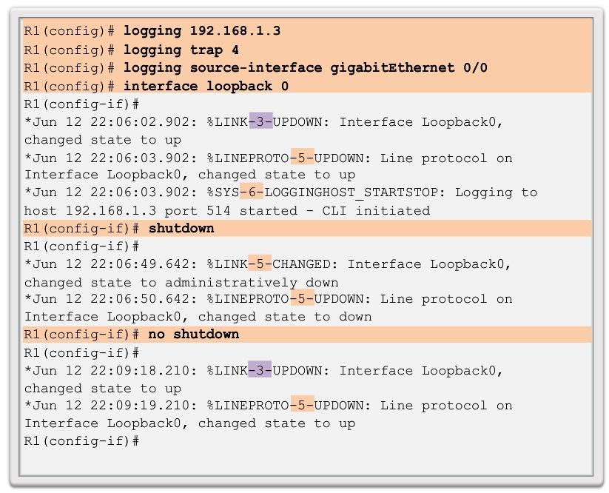
Configuring Syslog
Router and Switch Commands for Syslog Clients

Slide 15
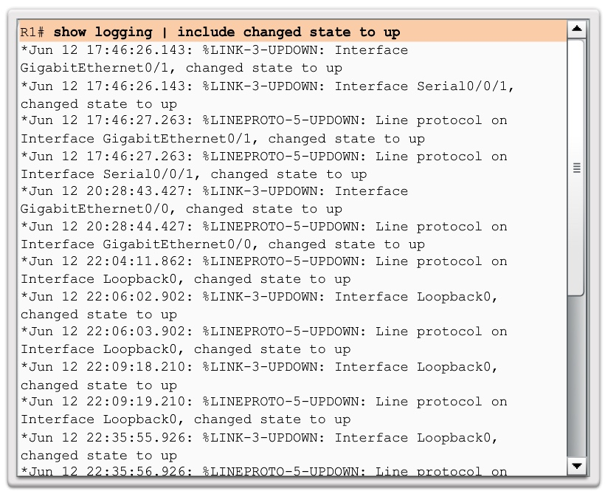
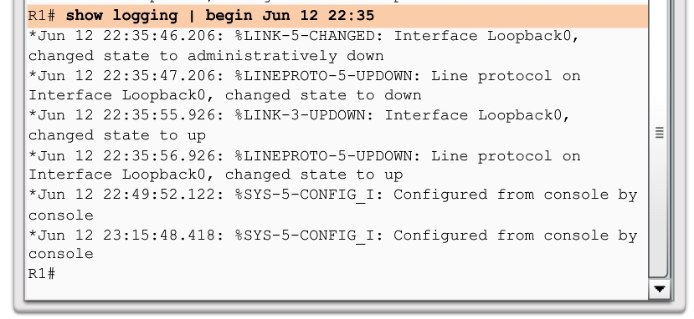
Configuring Syslog
Verifying Syslog

Slide 16
SNMP

Slide 17
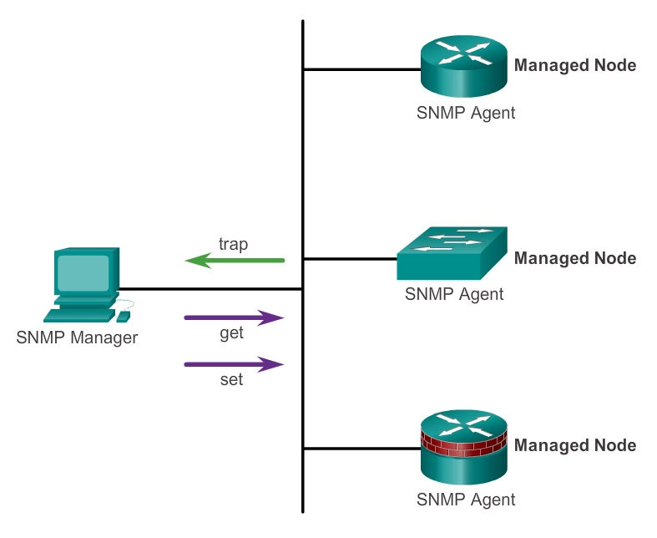
SNMP Operation
Introduction to SNMP

Slide 18
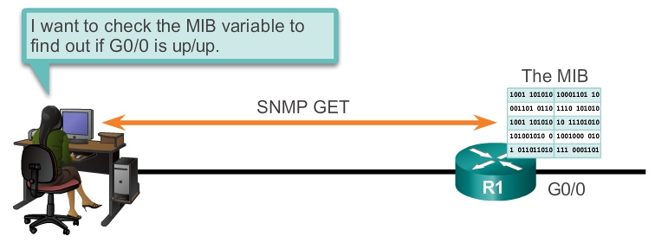
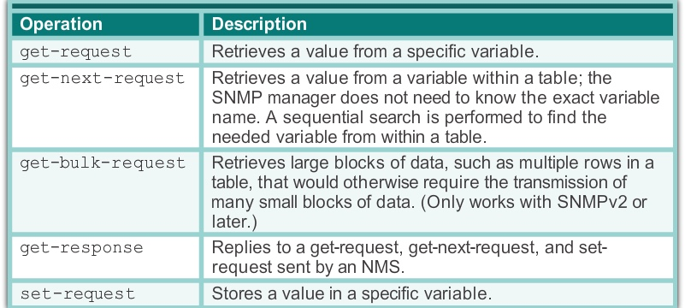
SNMP Operation
SNMP Operation

Slide 19
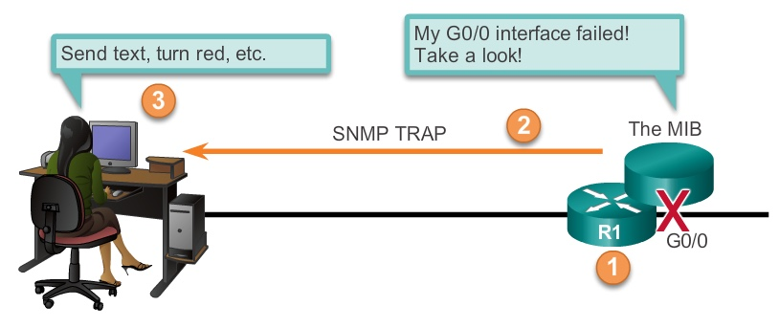
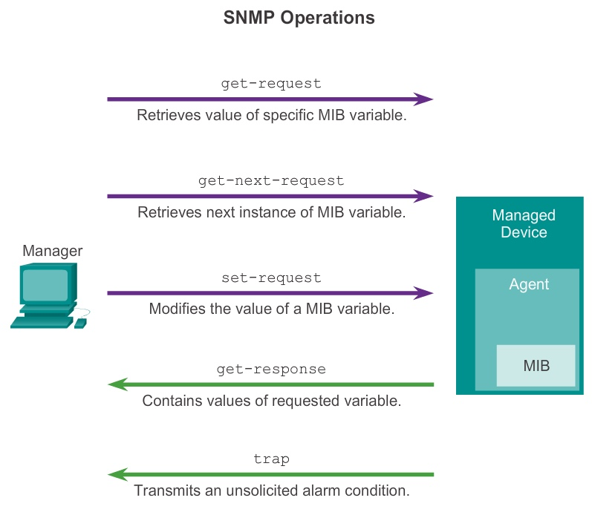
SNMP Operation
SNMP Agent Traps

Slide 20
SNMP Operation
SNMP Versions
There are several versions of SNMP, including:
▪ SNMPv1 - The Simple Network Management Protocol, a Full
Internet Standard, defined in RFC 1157.
▪ SNMPv2c - Defined in RFCs 1901 to 1908; utilizes community-
string-based Administrative Framework.
▪ SNMPv3 - Interoperable standards-based protocol originally
defined in RFCs 2273 to 2275; provides secure access to devices
by authenticating and encrypting packets over the network. It
includes these security features: message integrity to ensure that a
packet was not tampered with in transit; authentication to
determine that the message is from a valid source, and encryption
to prevent the contents of a message from being read by an
unauthorized source.

Slide 21
SNMP Operation
Community Strings
There are two types of community strings:
▪ Read-only (ro) – Provides access to the MIB variables, but does
not allow these variables to be changed, only read. Because
security is so weak in version 2c, many organizations use
SNMPv2c in read-only mode.
▪ Read-write (rw) – Provides read and write access to all objects in
the MIB.

Slide 22
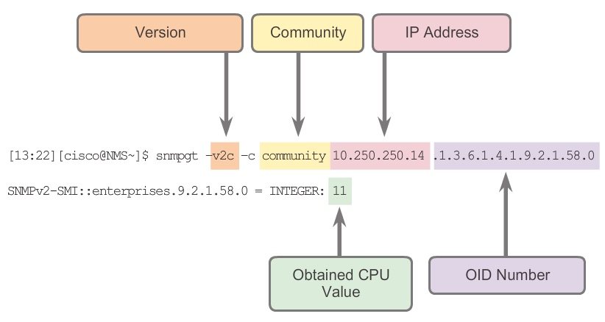
SNMP Operation
Management Information Base Object ID

Slide 23
Configuring SNMP
Steps for Configuring SNMP
Step 1. (Required) Configure the community string and access level
(read-only or read-write) with the snmp-server
community string ro | rw command.
Step 2. (Optional) Document the location of the device using the
snmp-server location text command.
Step 3. (Optional) Document the system contact using the snmp-
server contact text command.

Slide 24
Configuring SNMP
Steps for Configuring SNMP (cont.)
Step 4. (Optional) Restrict SNMP access to NMS hosts (SNMP
managers) that are permitted by an ACL. Define the ACL
and then reference the ACL with the snmp-server
community string access-list-number-or-name
command.
Step 5. (Optional) Specify the recipient of the SNMP trap operations
with the snmp-server host host-id [version {1 |
2c | 3 [auth | noauth | priv]}] community-
string command. By default, no trap manager is defined.
Step 6. (Optional) Enable traps on an SNMP agent with the snmp-
server enable traps notification-types
command.

Slide 25
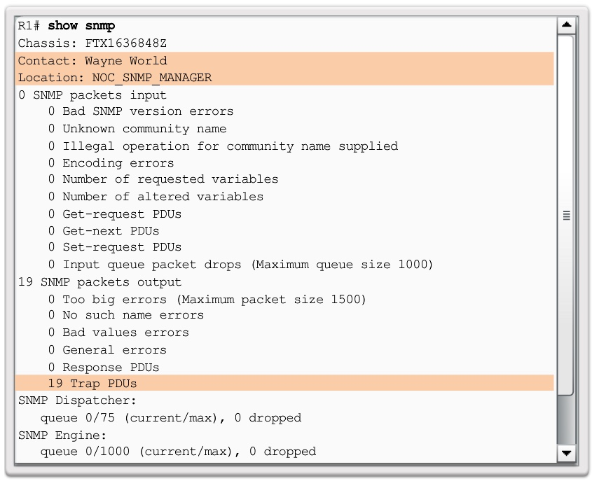
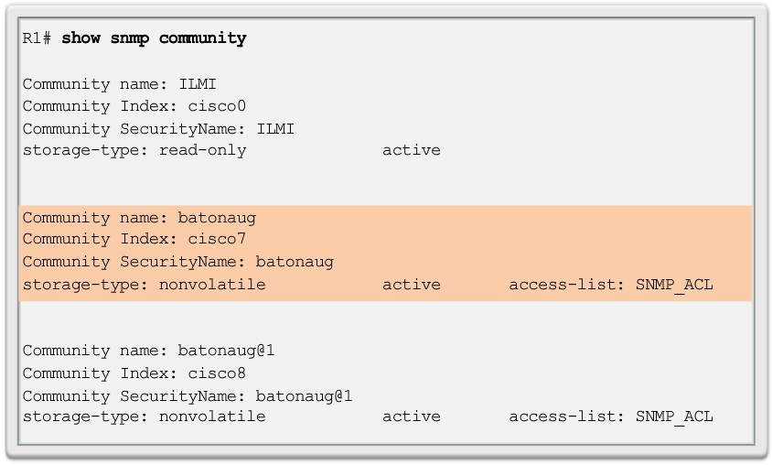
Configuring SNMP
Verifying SNMP Configuration

Slide 26
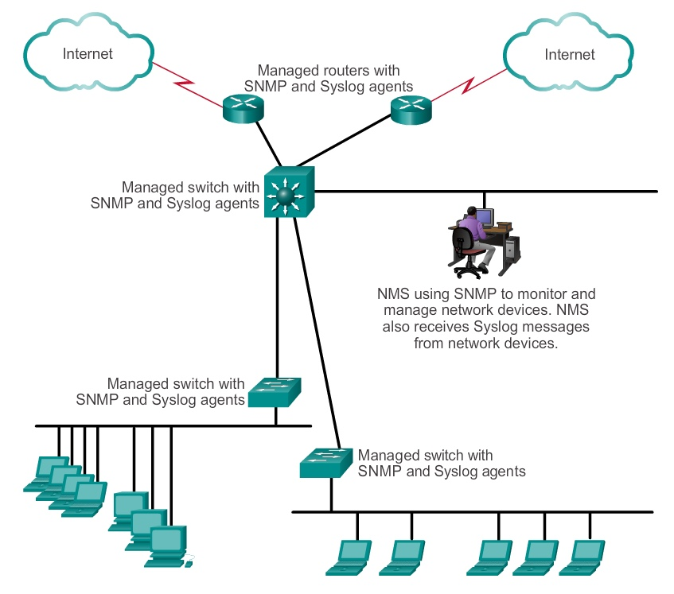
Configuring SNMP
Security Best Practices

Slide 27
NetFlow

Slide 28
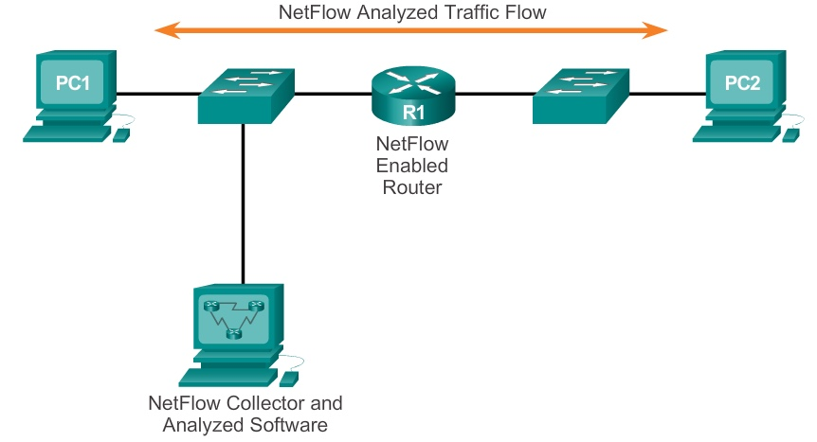
NetFlow Operation
Introduction to NetFlow

Slide 29
NetFlow Operation
Purpose of NetFlow
Most organizations use NetFlow for some or all of the following key
data collection purposes:
▪ Efficiently measuring who is using what network resources for what
purpose.
▪ Accounting and charging back according to the resource utilization
level.
▪ Using the measured information to do more effective network
planning so that resource allocation and deployment is well-
aligned with customer requirements.
▪ Using the information to better structure and customize the set of
available applications and services to meet user needs and
customer service requirements.

Slide 30
NetFlow Operation
Network Flows
NetFlow technology has seen several generations that provide more
sophistication in defining traffic flows, but “original NetFlow”
distinguished flows using a combination of seven key fields.
▪ Source and destination IP address
▪ Source and destination port number
▪ Layer 3 protocol type
▪ Type of service (ToS) marking
▪ Input logical interface

Slide 31
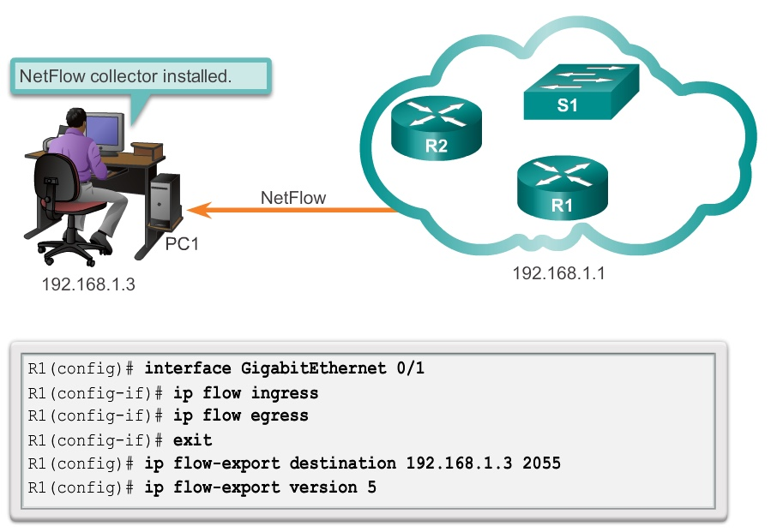
Configuring NetFlow
NetFlow Configuration Tasks

Slide 32
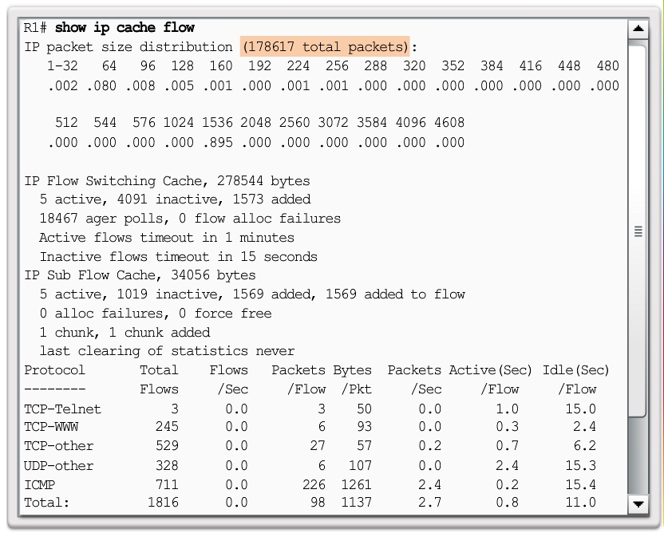
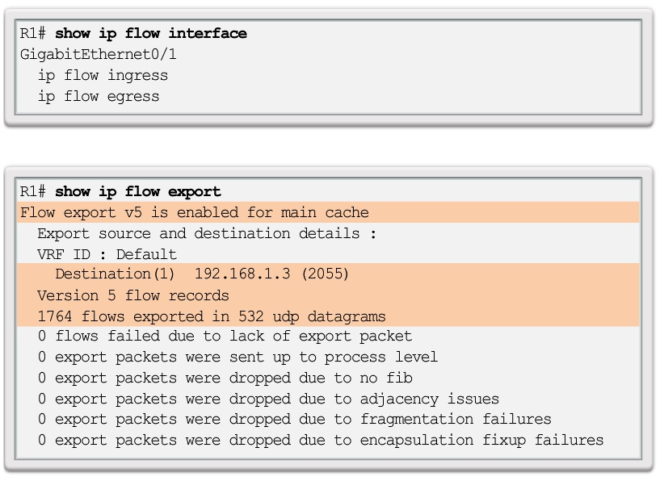
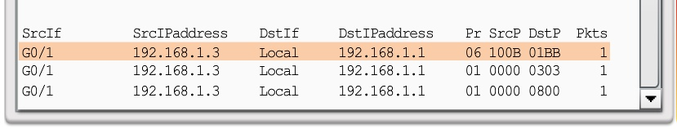
Examining Traffic Patterns
Verifying NetFlow

Slide 33
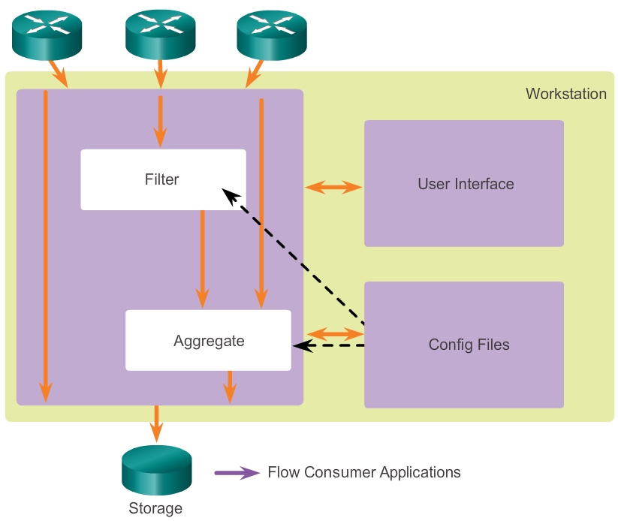
Examining Traffic Patterns
NetFlow Collector Functions

Slide 34
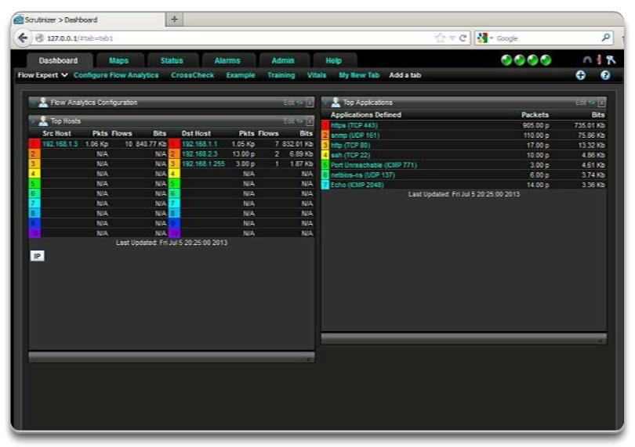
Examining Traffic Patterns
NetFlow Analysis with a NetFlow
Collector

